Slide 1
BETA MARKETPLACE Intelligence report: 2024/2025 Overview
By OFORAH IVAN CHUKWUDUMEJE.

Slide 2
CONTENT
Product Analysis
Customer Insight
Regional Distribution
Financial Overview
Recommendation
Acknowledgement

Slide 3

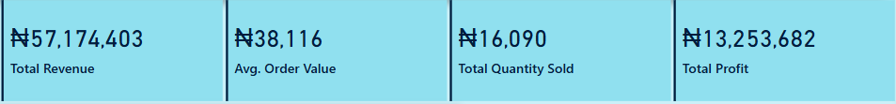
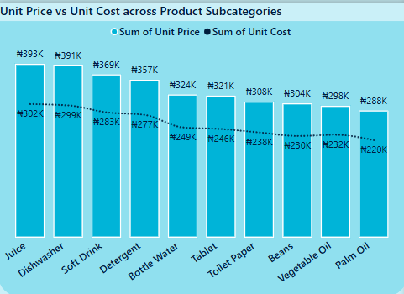
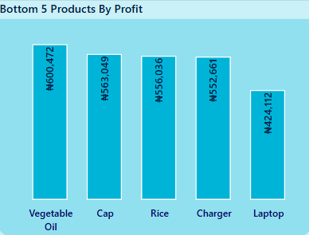
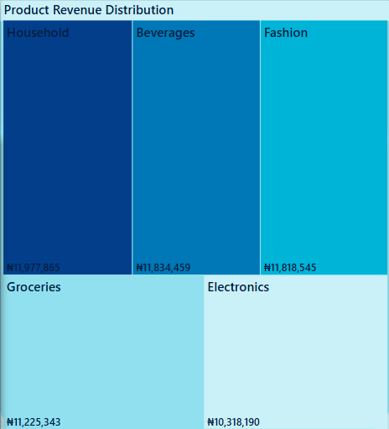
Product Analysis
The Unit cost is consistently lower than unit price, indicating profitability margins.
Juice, Dishwasher and Soft drink have a noticeable gap between Price and Cost indicating good profit margin.
Despite being part of profitable categories (Vegetable Oil), these specific products have low profit margins, possibly due to high unit cost, low selling price or low volume of sales.
Customers spend more on Household, Beverages, Fashion products with total revenue of N35,630,869
This might be as a result of current economic situation of Nigeria or simply high demands.

Slide 4

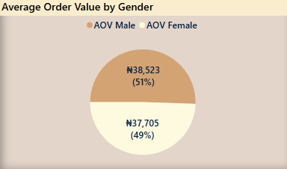
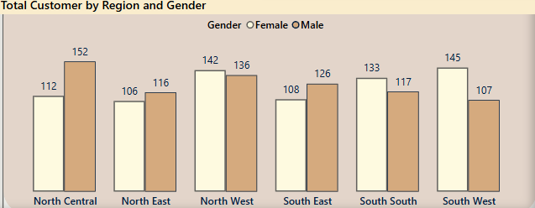
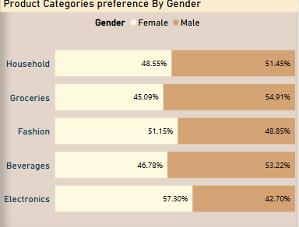
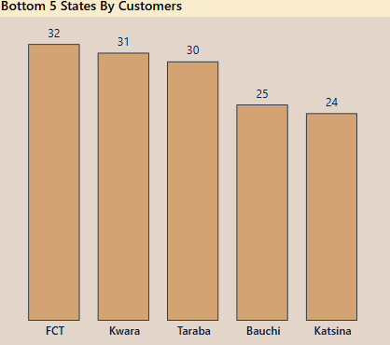
CUSTOMER INSIGHT
The similar Average Order Value between genders suggest consistent spending behavior, but the slight Male majority in Average Order Value(AOV) contribution aligns with higher representation (51% Males vs 49% Females) in the customer base.
Continue strong engagement in most active regions North West(278) customers and North Central (264) while investigating growth strategies in lower performing zones like South East and North East.
Males dominate in most categories like Groceries, Beverages, Household items while Females dominate in Fashion and Electronics. Bundle Female-targeted promotions and also create male-oriented bundles with household items & groceries.
These states represent the lowest customer base, indicating potential areas for targeted marketing, outreach or localized promotions to boost customer acquisition.

Slide 5

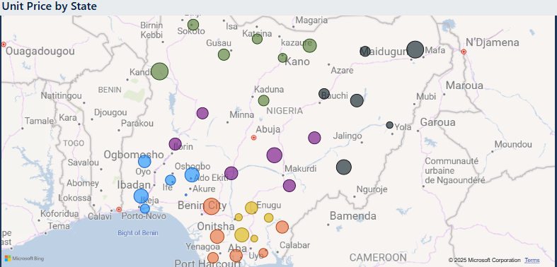
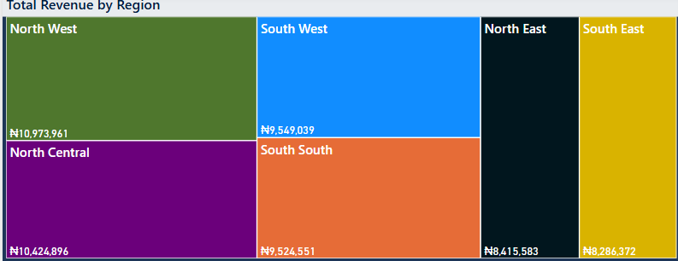
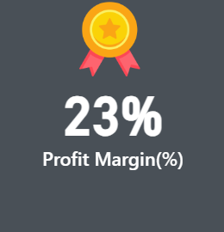
Regional Distribution Analysis
23% profit margin indicates a moderately healthy return, suggesting that while revenue are substantial, costs are also significant.
Strategic pricing or cost reduction could improve profitability.
Unit price variations suggest possible regional differences in product value, affordability, or distribution costs.
North West & North Central states with Lower Average unit prices tend to generate more revenue.
North West and North Central States characterized with lower average unit price of products that result to generation of more revenue.
South West and South East lag behind in total revenue despite being major economic zone in Nigeria, which may require further analysis.

Slide 6

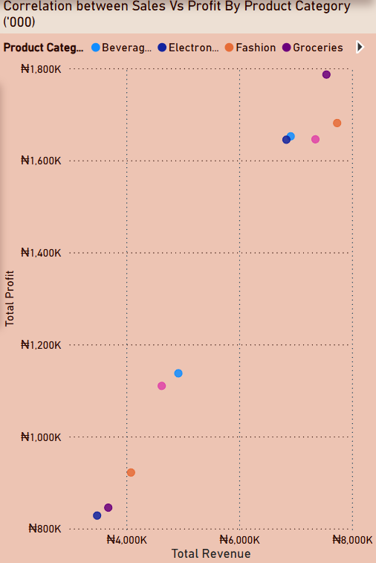
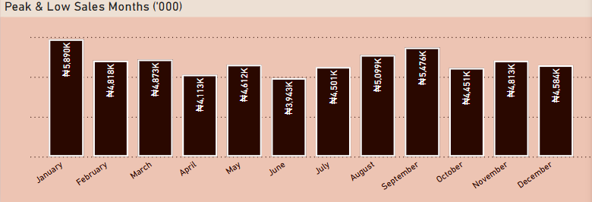
FINANCIAL OVERVIEW
January marks the strongest sales month while June made it as the lowest sales, possibly linked to mid-year market cooling and finally consistent performance were noticed in month of August and September.
Investigate and address Q4 drop (October – December) and also plan inventory and staffing around peak (Jan, Aug & Sept).
Observe customers behavior in mid-year and year-end trends
There’s a clear positive correlation between total revenue and total profit- as revenue increases , profit tends to increase.
This also suggests that the profitability scales well with increased sales volume across most product categories.
The top-right cluster(high revenue, high profit) include Fashion, Groceries, and household. These categories should be prioritized for further investment .
Focus on growing high performing categories(Fashion, Groceries, Household) and also revamp under performing ones(Like Beverages).

Slide 7

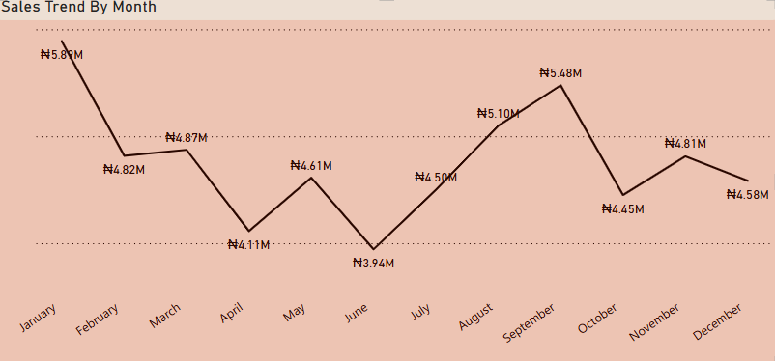
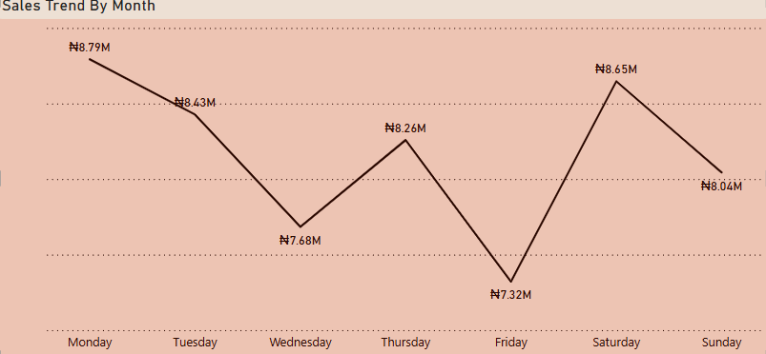
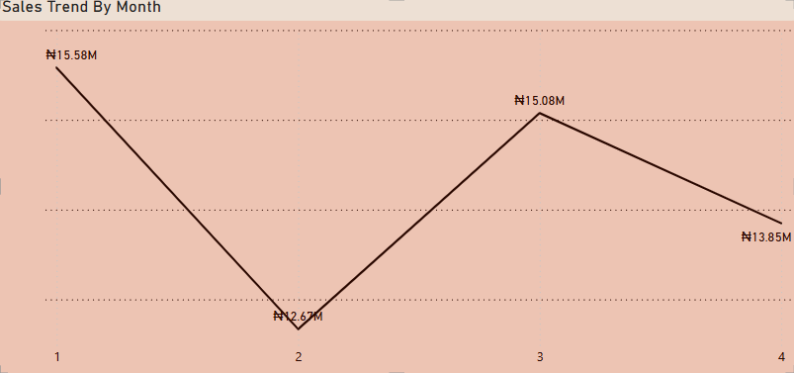
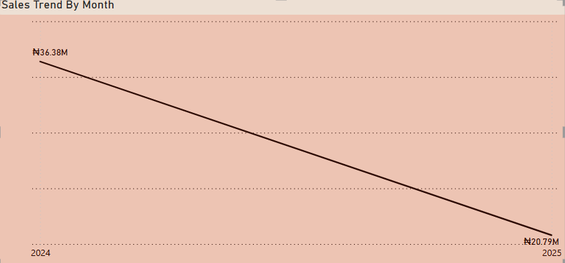
TIME INTELLIGENCE OVERVIEW:NAVIGATING DAILY, MONTHLY & QUARTERLY TRENDS
Seasonal trends are very evident with peaks on January(New year demand or holiday carryover), September & October(back-to-school or Early holiday spending).
Sales strategies should be reinforced in June(mid-year)and optimized for the year-end to prevent drop-offs.
Sales began to recover steadily on July(Q3) to a second peak in October (N5.48 million).
It is also important to note that Monday( due to carryover from weekend planning) and Saturday(weekend shopping pattern) are the top- performing days. Wednesday dip indicates mid-fatigue.

Slide 8


SUMMARY RECOMMENDATION
Reassess and optimize pricing strategy for low-profit products by observing the bottom 5 products by products. Investigate whether high unit costs, discount or operational inefficiencies are eroding profit margins.
Focus Marketing and stocking strategy on high revenue & Margin Products(Juice, dishwashers & detergent). Prioritize these products in promotion, inventory planning and ad spend. Consider cross selling them with other related products to drive even more value.
Consider analyzing why South-West and South-East lag in revenue despite economic potential. Also investigate the pricing strategy in states with low unit prices for potential margin optimization.
Boost Marketing around June to mitigate sales dips.
Analyze the customer behavior further to confirm reasons for mid-year and year-end trends.
Plan inventory and staffing around peak months (January, September and October).

Slide 9


ACKNOWLEDGEMENT
Special thanks to El-ROI for making this very day possible. I would like to express my heartfelt gratitude to Mr. & Mrs. Nosike for their generous financial support, without which this journey would not have been possible.
I’m also deeply grateful to Mr. Charles, the General Overseer, for his invaluable mentorship and for playing a pivotal role in bringing Digital Technology Business School London to Nigeria in an accessible and affordable way
Special thanks to Mrs. Chioma Muanya for her unwavering academic guidance and motivational support throughout the entire course program.
Unending appreciation also goes to my amazing colleagues such as Blessing 001, Perpsy, Lolo, Godson, Ogochukwu, Felix, Cynthia, Suanu and many others, whose dedication, collaboration, and contributions enriched the learning experience and made this journey truly remarkable.

